Slide 1
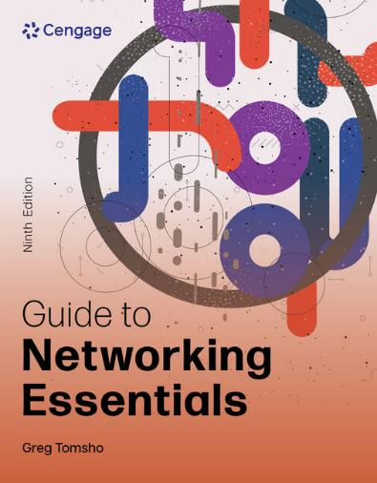
Guide to Networking Essentials, 9e
Chapter 3: Network Topologies and Technologies
.

Slide 2
Chapter Objectives
By the end of this chapter, you should be able to:
Describe the primary physical networking topologies in common use
Describe the primary logical networking topologies in common use
Describe major LAN networking technologies
Compare Wi-Fi standards
Describe ring topology networks

Slide 3
Physical Topologies
A network topology describes how a network is physically laid out and how signals travel from one device to another
The physical layout of the devices and cables doesn’t describe how signals travel from one device to another
The arrangement of cabling and how cables connect one device to another in a network is considered the network’s physical topology
The path data travels between computers on a network is considered the network’s logical topology
All network designs today are based on these basic physical topologies: bus, star, ring, and point-to-point

Slide 4
Physical Bus Topology (1 of 3)
Physical bus topology is defined as a continuous length of cable connecting one computer to another in daisy-chain fashion
Weaknesses include the following:
There’s a limit of 30 computers per cable segment
The maximum total length of cabling is 185 meters
Both ends of the bus must be terminated
Any break in the bus brings down the entire network
Adding or removing a machine brings down the entire network temporarily
Maximum speed is 10 Mbps half-duplex communication

Slide 5
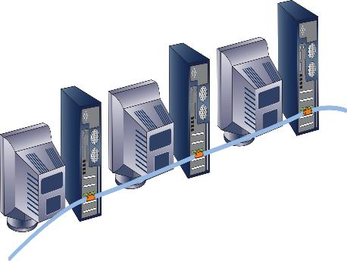
Physical Bus Topology (2 of 3)
Figure 3-1 A physical bus topology network
This topology is now considered obsolete.

Slide 6
Physical Bus Topology (3 of 3)
How Data Travels in a Physical Bus
Electrical pulses (signals) travel the cable’s length in all directions
Signals traveling across the medium and from device to device is called signal propagation
The signal continues until it weakens or is absorbed by a terminator
A terminator is an electrical component called a resistor that absorbs the signal instead of allowing it to bounce back up the wire
If not terminated, the signal bounces or is “reflected” at end of medium, called signal bounce

Slide 7
Physical Star Topology (1 of 5)
The physical star topology uses a central device (hub or switch) to connect computers
Advantages include the following:
Much faster technologies than a bus
Centralized monitoring and management of network traffic are possible
Easier network upgrades
Using a central device allows for monitoring and managing a network
When the number of workstations you need exceeds the number of ports on a central device you simply add another central device

Slide 8
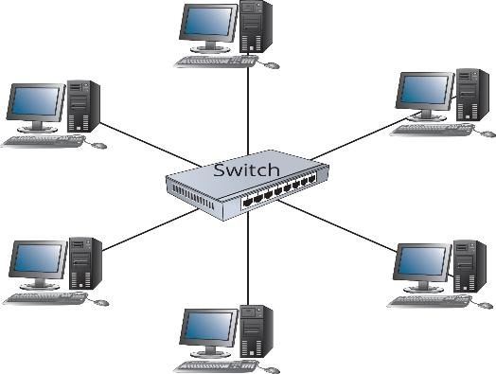
Physical Star Topology (2 of 5)
Figure 3-2 A physical star topology network

Slide 9
Physical Star Topology (3 of 5)
The extended star topology is the most widely used in networks containing more than just a few computers
A central device (usually a switch) sits in the middle and instead of attached computers, other switches or hubs are connected to the central switch’s ports
Computers and peripherals are attached to these switches or hubs forming additional stars
Sometimes referred to as a “hierarchical star”
This topology is most effective when the center of the star is running at a much faster speed than other devices

Slide 10
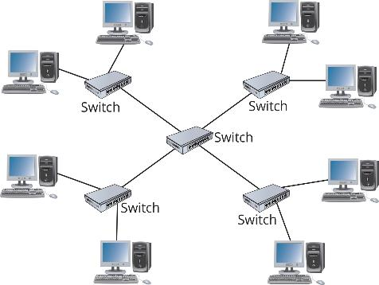
Physical Star Topology (4 of 5)
Figure 3-3 An extended star topology network

Slide 11
Physical Star Topology (5 of 5)
Details of how data travels in a physical star depend on the central device
The central device determines the ‘logical’ topology (discussed later)
For now: hub = logical bus; switch = logical switching; MAU = logical ring (media access unit)
The main disadvantage is that the central device represents a single point of failure
If the hub or switch fails or someone kicks the power cord out of the outlet, the entire network goes down

Slide 12
Physical Ring Topology (1 of 2)
A physical ring topology is like a bus, in that devices are daisy-chained one to another
Instead of terminating each end, the cabling is brought around from the last device back to the first device to form a ring
This topology was most widely used to connect LANs with a technology called Fiber Distributed Data Interface (FDDI)
FDDI was most often used as a network backbone, which is cabling used to communicate between LANs or between hubs and switches
Data travels in one direction

Slide 13
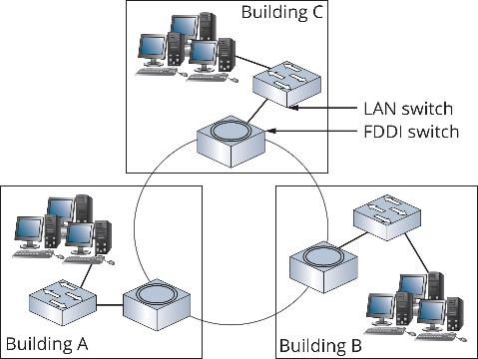
Physical Ring Topology (2 of 2)
Figure 3-4 A physical ring topology is typically used to connect LANs

Slide 14
Point-to-Point Topology (1 of 5)
A point-to-point topology is a direct link between two devices
Data travels on a dedicated link and bandwidth is not shared with other networks
Point-to-point technologies are used with wireless networks as a wireless bridge
This setup can be used to connect two buildings without using a wired network
It can also be used to connect two computers together for transferring files

Slide 15
Point-to-Point Topology (2 of 5)
A point-to-multipoint (PMP) topology is an arrangement where a central device communicates with two or more other devices
All communication goes through the central device
It is often used in WANs where a main office has connections to several branch offices via a router
A single connection is made from the router to a switching device that directs traffic to the correct branch office
A single base station communicates with multiple subscriber stations

Slide 16
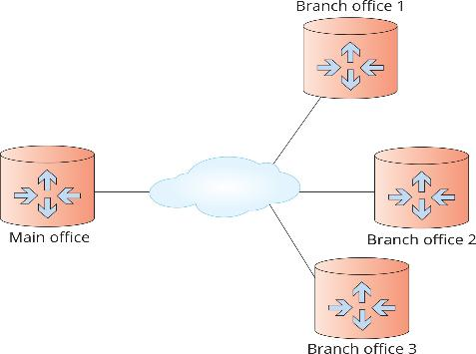
Point-to-Point Topology (3 of 5)
Figure 3-6 A point-to-multipoint topology

Slide 17
Point-to-Point Topology (4 of 5)
A mesh topology connects each device to every other device in a network
There are multiple point-to-point connections for the purposes of redundancy and fault tolerance
The purpose of creating a mesh topology is to ensure that if one or more connections fail, there’s another path for reaching all devices on the network
This topology is found in large WANs and internetworks
It is expensive due to additional cabling and ports required

Slide 18
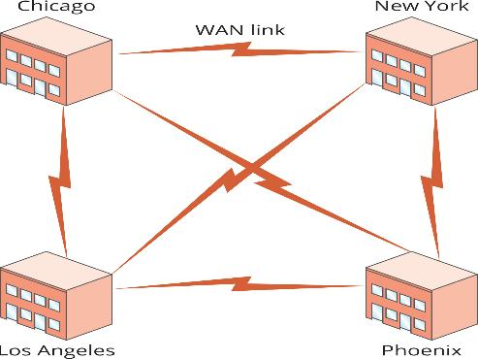
Point-to-Point Topology (5 of 5)
Figure 3-7 Switches in each building are connected in a full mesh topology

Slide 19
Logical Topologies (1 of 3)
A network’s logical topology describes how data travels from computer to computer
In some cases, it is the same as the physical topology
For a physical star, the central device determines the logical topology
A logical ring using a physical star implements the ring inside the central device’s electronics, which is a MAU in the token ring technology
In a switched topology, there is always an electrical connection between the computer and the switch

Slide 20
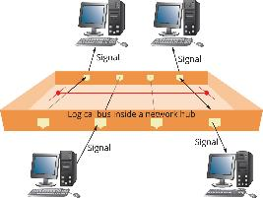
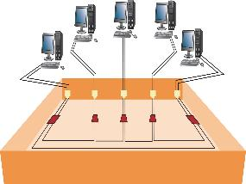
Logical Topologies (2 of 3)
Figure 3-8 A logical bus implemented as a physical star
Figure 3-9 A logical ring implemented as a physical star

Slide 21
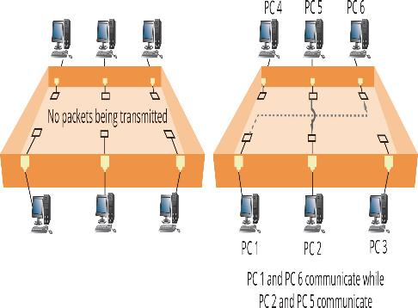
Logical Topologies (3 of 3)
Figure 3-10 The logical functioning of a switch

Slide 22
Knowledge Check Activity 3-1
What term describes how electricity behaves when it reaches the end of an unterminated cable?
a. Signal resistance
b. Signal propagation
c. Signal absorption
d. Signal bounce

Slide 23
Knowledge Check Activity 3-1: Answer
What term describes how electricity behaves when it reaches the end of an unterminated cable?
Answer: d. Signal bounce
Explanation: The term used when electricity bounces off the end of a cable and back in the other direction is called signal bounce (or “reflection”). The traveling of data across the medium is called signal propagation. Signal absorption is when a signal is absorbed by a terminator device and resistance is a property of cabling that causes signal attenuation.

Slide 24
Network Technologies
Network technology is the method a network interface uses to access the medium and send data frames and the structure of these frames
Other terms include the following:
Network interface layer technologies, network architectures, and data link layer technologies
A network uses Ethernet, 802.11 wireless, or some combination of these to move data from device to device in your network
WAN examples include MPLS, SONET, and ATM (discussed in Chap. 10)
The network technology often defines frame format and media

Slide 25
Network Technologies and Media (1 of 2)
Unshielded twisted pair (UTP) is the most common media type in LANs
Consists of 4 pairs of copper wires, with each pair twisted together
It comes in numbered categories
The higher the number, the higher the cable’s bandwidth potential
Fiber-optic cabling uses thin strands of glass to carry pulses of light long distances and at high data rates
It isn’t susceptible to electrical interference
Can be used in electrically noisy environments

Slide 26
Network Technologies and Media (2 of 2)
Coaxial cable is obsolete as a LAN medium but it is used as the network medium for Internet access via cable modem
Network technologies can use media to transmit signals in two main ways
Baseband sends digital signals in which each bit of data is represented by a pulse of electricity or light
Sent at a single fixed frequency and no other frames can be sent along with it
Broadband uses analog techniques to encode binary 1s and 0s across a continuous range of values
Signals flow at a particular frequency and each frequency represents a channel of data

Slide 27
Ethernet Networks (1 of 8)
Ethernet is the most popular LAN technology
Advantages include ease of installation, scalability, media support, and low cost
It supports a broad range of speeds: 10 Mbps to 100 Gbps
Ethernet can operate in a physical bus or physical star and a bus or switched logical topology
Most NICs and switches can operate at multiple speeds: 10/100/1000
The underlying technology is the same, regardless of speed

Slide 28
Ethernet Networks (2 of 8)
Ethernet Addressing
Every Ethernet station has a physical (MAC) address
Each MAC address has 48 bits expressed as 12 hexadecimal digits
Incoming frames are read for the destination MAC address and to see if they match the NIC’s own MAC address
If they match or if the destination address is the broadcast MAC address, incoming frames are sent to the network protocol for further processing

Slide 29
Ethernet Networks (3 of 8)
Ethernet Frames
A frame is the unit of information that NICs and switches work with
Frames must be between 64 and 1518 bytes and consist of the following:
A 14-byte frame header composed of these three fields:
Destination MAC (6 bytes)
Source MAC (6 bytes)
Type (2 bytes)
A Data field from 45 to 1500 bytes
A frame trailer (frame check sequence [FCS]) of 4 bytes

Slide 30
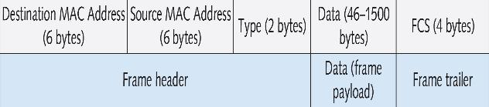
Ethernet Networks (4 of 8)
Figure 3-12 Ethernet frame format

Slide 31
Ethernet Networks (5 of 8)
Ethernet Media Access
Media access method is a set of rules governing how and when the medium can be accessed for transmission
Ethernet uses Carrier Sense Multiple Access with Collision Detection (CSMA/CD)
“Carrier sense” means to listen before send – must hear silence
“Multiple access” means if two or more stations hear silence, multiple stations may transmit at the same time
Collision detection: If two or more stations transmit, a collision occurs and is detected by the NIC; all stations must retransmit

Slide 32
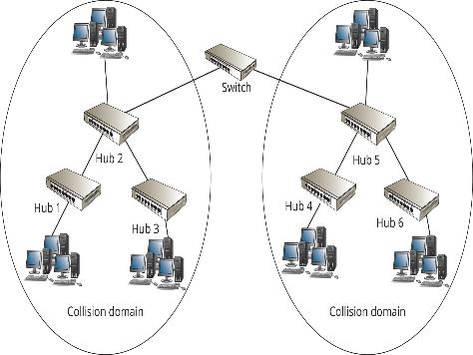
Ethernet Networks (6 of 8)
Figure 3-13 A network diagram showing two collision domains delimited by a switch
The extent to which signals in an Ethernet bus topology network are propagated is called a collision domain.

Slide 33
Ethernet Networks (7 of 8)
Ethernet Error Handling
Ethernet is a best-effort delivery system
There’s no acknowledgement or verification that the frame arrived at its intended destination
Ethernet relies on network protocols to ensure delivery
Ethernet detects damaged frames
The error-checking code in a frame’s trailer is called a Cyclic Redundancy Check (CRC)
Ethernet uses the CRC to determine that data is unchanged
If a frame is detected as damaged, it is discarded with no notification

Slide 34
Ethernet Networks (8 of 8)
Half-Duplex versus Full-Duplex Communication
Half-duplex works like a two-way radio; you can talk and listen but not both at the same time
When hubs are used, NICs can only operate in half-duplex mode
Full-duplex means NIC/switch can transmit/receive simultaneously
CSMA/CD is not used because a collision cannot occur in full-duplex mode (Carrier Sense Multiple Access with Collision Detection)
Full-duplex mode eliminates the delays caused by CSMA/CD and allows double the network bandwidth

Slide 35
Ethernet Standards (1 of 4)
Part 2
Ethernet standards expressed in one of two ways:
Using the IEEE document number defining the standard (IEEE 802.3)
XBaseY – 10BaseT, 100BaseT, 100BaseFX
X – designates the speed of transmission
Y – specifies the type of media (T = twisted-pair, FX = fiber optic)
10BaseT Ethernet
Uses two of the four wire pairs and runs over Category 3 or higher UTP cabling
It is highly susceptible to collisions and is obsolete

Slide 36
Ethernet Standards (2 of 4)
100BaseTX Ethernet is a common Ethernet variety
It runs over Category 5e or higher UTP
Uses two of four wire pairs
Also sometimes called “Fast Ethernet”
100BaseFX Ethernet runs over two strands of fiber optic cabling
It is typically used as backbone cabling between hubs or switches
Also used to connect clients or servers when immunity to noise and eavesdropping is required

Slide 37
Ethernet Standards (3 of 4)
1000BaseT Ethernet is usually called “Gigabit Ethernet”
It runs over Category 5e or higher UTP and uses all four wire pairs
To support full-duplex transmission over a single pair of wires:
1000BaseT uses hybrid and canceller technology, which combines multiple signals and cancels interference
2.5GBaseT and 5GBaseT
This specification was largely in response to increasing Wi-Fi speeds
It runs over Cat 5e/6 cabling, so there is no need for a change in wiring infrastructure

Slide 38
Ethernet Standards (4 of 4)
10GBaseT Ethernet runs over four pairs of Category 6A or 7 UTP
It operates only in full-duplex mode
No hubs, only switches support 10GBaseT
It is still considered an expensive option, although prices are dropping
Good for network servers so they can keep up with desktop systems that commonly operate at 1 Gbps
The primary use of 10 Gigabit Ethernet technologies is as the network backbone

Slide 39
Additional Ethernet Standards (1 of 3)
100BaseT4 uses all four pairs of wires in UTP Category 3 cable
It is considered obsolete
1000BaseLX uses fiber-optic media
“L” stands for “long wavelength” laser
It supports a maximum cable segment length of 5000 meters
1000BaseSX uses fiber-optic media
“S” stands for “short wavelength” laser, so it can’t cover as much distance as long-wavelength lasers, but they are less expensive

Slide 40
Additional Ethernet Standards (2 of 3)
1000BaseCX uses specially shielded, balanced, copper jumper cables
Might also be called “twinax” or “short-haul” copper cables
10 Gigabit Ethernet IEEE 802.3ae Standards are defined to run only on fiber-optic cabling and specifies a maximum distance of 40 kilometers
It is primarily used for network backbones
Varieties include 10GBaseSR, 10GBaseLR, 10GBaseER, 10GBaseSW, 10GBaseLW, and 10GBaseEW

Slide 41
Additional Ethernet Standards (3 of 3)
40 and 100 Gigabit Ethernet switch ports are usually found as one or two uplink ports on switches
Fiber optic cabling is primary medium, 40 Gbps is supported over Category 8 twisted-pair for up to 30 meters
25 and 50 Gigabit Ethernet most commonly use fiber optic cabling, 25 Gbps is available over Category 8 twisted-pair for up to 30 meters
In 2024, work began on 200, 400, and 800 Gbps Ethernet using 100 Gbps lanes and a task force to work on speeds up to 1.6 Terabits per second (Tbps) is scheduled for spring 2026

Slide 42
802.11 Wi-Fi
The 802.11 wireless networking standard is also referred to as Wireless Fidelity (Wi-Fi)
In most towns you can usually find a public Wi-Fi network, called a hotspot
802.11 is essentially an extension to Ethernet, using airwaves instead of cabling as the medium
802.11 networks can extend from several feet to several thousand feet

Slide 43
Wi-Fi Modes of Operation
Wi-Fi can operate in one of the following modes:
Infrastructure mode uses a central access point (AP)
Stations connect through a wireless AP before they can communicate with other devices
Ad hoc mode is a mode of operation where there is no central device
Data travels from device to device like a bus and sometimes called “peer-to-peer mode”
Most of this chapter’s discussion of Wi-Fi focuses on infrastructure mode

Slide 44
Wi-Fi Channels and Frequencies (1 of 2)
Wi-Fi networks operate at one of three radio frequencies: 2.4GHz, 5 GHz, and 6 GHz
This frequency is not fixed
A wireless channel works like a TV channel:
You must tune to the correct channel to connect
If you are configuring several Wi-Fi networks:
Choose channels five apart from other known APs

Slide 45
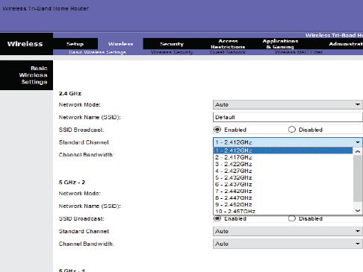
Wi-Fi Channels and Frequencies (2 of 2)
Figure 3-19 Selecting a Wi-Fi channel on an access point

Slide 46
Wi-Fi Antennas
The antenna on a Wi-Fi device is both transmitter and receiver
Characteristics and placement determine how well a device transmits or receives Wi-Fi signals
Antennas are usually categorized by their radiation pattern:
Omnidirectional antenna – the signal radiates out from the antenna with equal strength in all directions
Unidirectional antenna – signals are focused in a single direction
Ideal for placement at one end of long, narrow spaces

Slide 47
Wi-Fi Access Methods and Operation
Wi-Fi devices use Carrier Sense Multiple Access with Collision Avoidance (CSMA/CA)
An acknowledgement is required for every packet sent
802.11 standards specify a feature that uses handshaking before transmission
Uses request-to-send/clear-to-send (RTS/CTS) packets and acknowledgements
The 802.11b standard specifies a transmission rate of 11 Mbps
Environmental conditions can prevent transmission at this speed

Slide 48
Wi-Fi Signal Characteristics (1 of 2)
Types of signal interference caused by physical objects include:
Absorption — solid objects absorb radio signals, causing attenuation (weakening of the signal)
Refraction — the bending of a radio signal as it passes from a medium of one density through a medium of a different density
Diffraction — the altering of a wave as it tries to bend around an object
Reflection — occurs when a signal hits a dense, reflective material, resulting in signal loss
Scattering — when a signal changes direction in unpredictable ways, causing a loss in signal strength

Slide 49
Wi-Fi Signal Characteristics (2 of 2)
Signal-to-noise ratio is the amount of noise compared with the signal strength
Noise can come from equipment, other wireless devices, and other wireless networks
Throughput is the actual amount of data transferred, not counting errors and acknowledgements
Goodput is actual application-to-application data transfer speed
Extra megabytes in packet frame headers, acknowledgements, and retransmissions are collectively known as overhead

Slide 50
Wi-Fi Standards (1 of 3)
Advantages and disadvantages of each standard:
802.11b — was the most widely accepted standard because of its low cost and good indoor range
Because it operates at only 11 Mbps, 802.11g and 802.11n have rapidly replaced it
802.11a — requires more power and has a shorter indoor range, transfers data at 54 Mbps
802.11g — suffers from the same interference problems as 802.11b networks
802.11n — adds multiple-input/multiple-output (MIMO) antennas

Slide 51
Wi-Fi Standards (2 of 3)
Advantages and disadvantages of each standard (continued):
802.11ac — operates in the 5.0 GHz range only and can support data rates up to 1 Gbps
Improves on the MIMO technology by providing up to eight data streams and introducing multiuser MIMO (MU-MIMO), which allows APs to send data to multiple client stations simultaneously
802.11ax — known as Wi-Fi 6 and can provide speeds up to 9.6 Gbps using 160 MHz wide channels
With this standard, the Wi-Fi Alliance introduced the new, simpler naming scheme, using numbers (Wi-Fi 5, Wi-Fi6, etc.)

Slide 52
Wi-Fi Standards (3 of 3)
Advantages and disadvantages of each standard (continued):
802.11be (Wi-Fi 7) — the newest adopted 802.11 standards that operates in the 2.4 GHz, 5 GHz, and 6 GHz bands
In the 6 GHz band, it doubles the channel bandwidth to 320 MHz, allowing speeds up to 46 Gbps
802.11bn (Wi-Fi 8) — the next iteration of the 802.11 standard
It promises speeds up to 100 Gbps

Slide 53
Wi-Fi Security
Signals from a Wi-Fi network can travel several hundred feet, so Wi-Fi devices outside your home or business can detect your signals
A Wi-Fi network should be protected by an encryption protocol that makes data difficult to interpret
Encryption protocols include Wired Equivalent Privacy (WEP), Wi-Fi Protected Access (WPA), and WPA2
Not all devices support all three protocols
Wi-Fi encryption is configured on the AP

Slide 54
Token Ring
Token ring is based on the IEEE 802.5 standard and are cabled in a star physical topology but function as a logical ring topology
Originally operated at 4 Mbps and then increased to 16 Mbps and later 100 Mbps
Uses cat 4 and higher UTP
A token is passed along the network
Only the station with the token can transmit
Frames are acknowledged and token is released
There are no collisions

Slide 55
Fiber Distributed Data Interface Technology
Fiber Distributed Data Interface (FDDI) uses a token-passing access method and dual rings for redundancy
The rings are usually a physical ring of fiber-optic cable
FDDI transmits at 100 Mbps and can include up to 500 nodes over a distance of 62 miles
FDDI full-duplex technology can support up to 200 Mbps
Devices called “concentrators” can serve as a central connection point for buildings or sites in a campus setting
This technology is obsolete on new networks

Slide 56
Knowledge Check Activity 3-2
Wi-Fi networks currently operate in which three frequencies?
a. 2.4 MHz, 5 MHz, 6 MHz
b. 2.4 GHz, 5 GHz, 6 GHz
c. 11 MHz, 54 MHz, 108 MHz
d. 11 GHz, 54 GHz, 108 GHz

Slide 57
Knowledge Check Activity 3-2: Answer
Wi-Fi networks currently operate in which three frequencies?
Answer: b. 2.4 GHz, 5 GHz, 6 GHz
Explanation: While some of the Wi-Fi standards operate in either the 2.4 GHz or 5 GHz frequencies, some standards operate in both frequencies. The Wi-Fi 6e standard operates in the 2.4 GHz, 5 GHz, and 6GHz frequencies.

Slide 58
Self Assessment
Name the differences between physical topology and logical topology.
You’re configuring a WLAN in a long, narrow ballroom. The only place you can put the AP is at the far end of the room. Which type of antenna should you use?

Slide 59
Summary
Now that the lesson has ended, you should be able to:
Describe the primary physical networking topologies in common use
Describe the primary logical networking topologies in common use
Describe major LAN networking technologies
Compare Wi-Fi standards
Describe ring topology networks

